Slide 1

Configuring Access
Control
M.SRIJA
22H51A05G8
CSE-D

Slide 2

Introduction to Access Control
Access control plays a critical role in safeguarding data and systems. By implementing access control measures, organizations can ensure that sensitive information and resources are protected from unauthorized access. It is a fundamental security practice that helps maintain confidentiality, integrity, and availability of data within an organization. Effective access control mechanisms prevent breaches and limit potential damage from unauthorized users

Slide 3

Defining Access Control
Access control involves defining and enforcing rules that determine who can access what resources and under what conditions.
Authorization
Authentication
The process of granting or denying access to specific resources based on user roles and permissions.
The process of verifying the identity of a user or device before granting access to resources.

Slide 4
Types of Access Control Systems
There are several types of access control systems, each with its own strengths and weaknesses.
Role-Based Access Control (RBAC)
Attribute-Based Access Control (ABAC)
Rule-Based Access Control (RBAC)
Access is granted based on user roles and associated permissions.
Access is granted based on user attributes, resource attributes, and context.
Access is granted based on pre-defined rules that specify conditions for access.

Slide 5
Access Control Policies and Procedures
Access control policies define the rules and guidelines for managing access to resources.
1
Data Classification
2
Least Privilege Principle
3
Separation of Duties
Categorizing data based on sensitivity and importance.
Users should only have access to the resources they need to perform their job duties.
Dividing critical tasks between multiple users to prevent fraud or abuse.

Slide 6
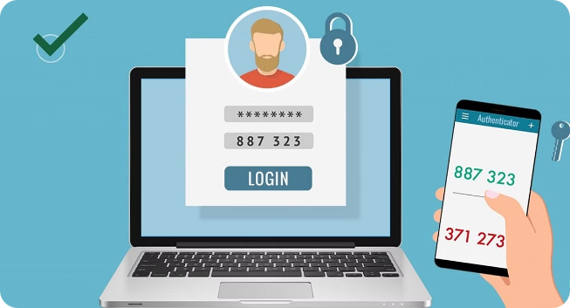
User Authentication Methods
User authentication methods verify the identity of users before granting access.
1
Password-Based Authentication
Users provide a password to verify their identity.
2
Multi-Factor Authentication (MFA)
Users provide multiple factors of authentication, such as a password and a one-time code.
3
Biometric Authentication
Users provide biometric data, such as fingerprint or facial recognition, to verify their identity.

Slide 7




Access Control Implementation Best Practices
Implementing access control effectively requires careful
planning and execution.
Regularly Review and Update Policies
Ensure policies are up-to-date and aligned with
current security needs.
Implement Strong Password Policies
Require complex passwords and encourage regular
password changes.
Train Users on Security Best Practices
Educate users on the importance of access control and how to protect their credentials.

Slide 8

Conclusion and Key Takeaways
Access control is critical for securing data and systems. By implementing effective access control practices, organizations can protect sensitive information, minimize security risks, and maintain compliance with regulatory requirements.
Strong Security
Access control is the cornerstone of a robust security
posture.
Data Integrity
Protecting data from unauthorized access ensures its
Integrity and reliability.
Compliance
Access control helps organizations meet compliance
requirements and legal obligations.

Slide 9

THANK YOU

